Slide 1

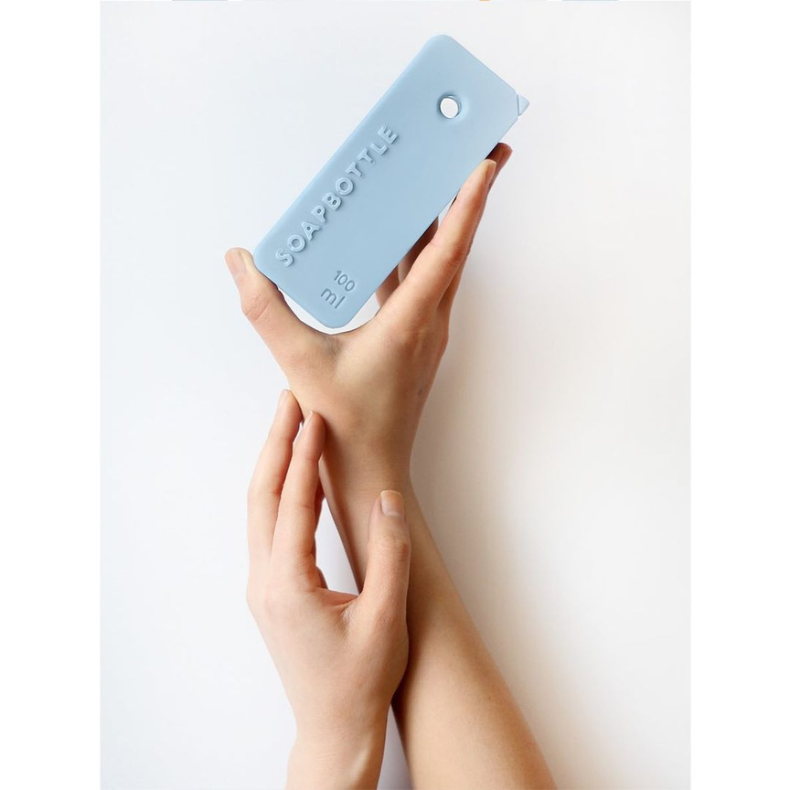
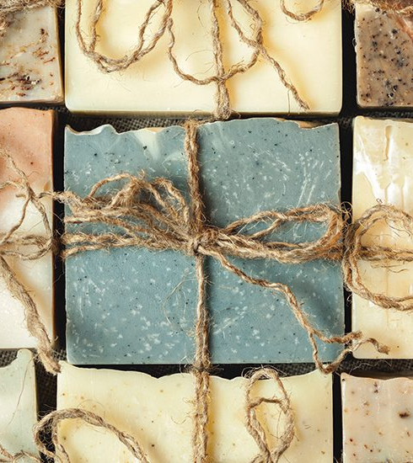
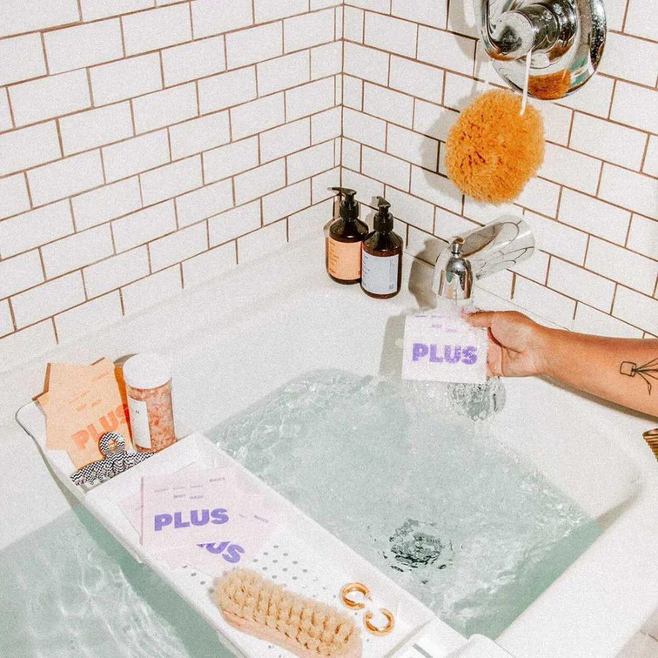
DISSOLVABLE & NAKED
PACKAGING
PREETI BAGUL
AOO2

Slide 2
WHAT IS
NAKED PACKAGING
ADVANTAGES
Reduces waste
Minimalist appeal
Cost-effective
Lower environmental impact
Promotes innovative design
Market differentiation
Attracts eco-conscious consumers
Simplifies product use
Naked packaging refers to a minimalist approach to product design where the item is sold without any traditional packaging materials like plastic, paper, or cardboard. This concept is gaining traction in the cosmetic industry as brands and consumers alike seek to reduce waste and minimize environmental impact. By eliminating packaging, companies are not only cutting down on production costs and materials but also promoting a sustainable lifestyle.

Slide 3
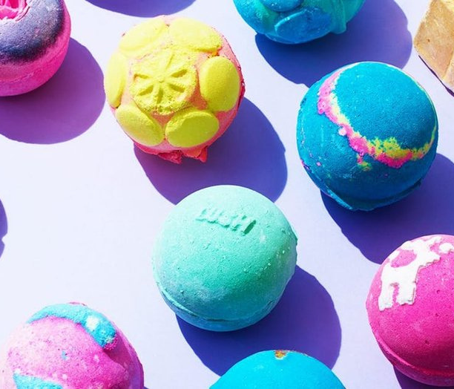
LUSH
LUSH are moving some of their most popular products from typical plastic based packaging to ‘solid bars’, also known as ‘Naked packaging’ as a method of eliminating all packaging. Of course not all of lush’s products can be without any packaging. However for the majority of their products with the change of recipe once liquid forms have transcended to solid bars. Allowing for the ‘Naked’ packaging. This change is on a systematic, manufacturing, and product level.
66%
OF THE PRODUCTS SOLD BY LUSH IN A YEAR ARE NAKED

Slide 4
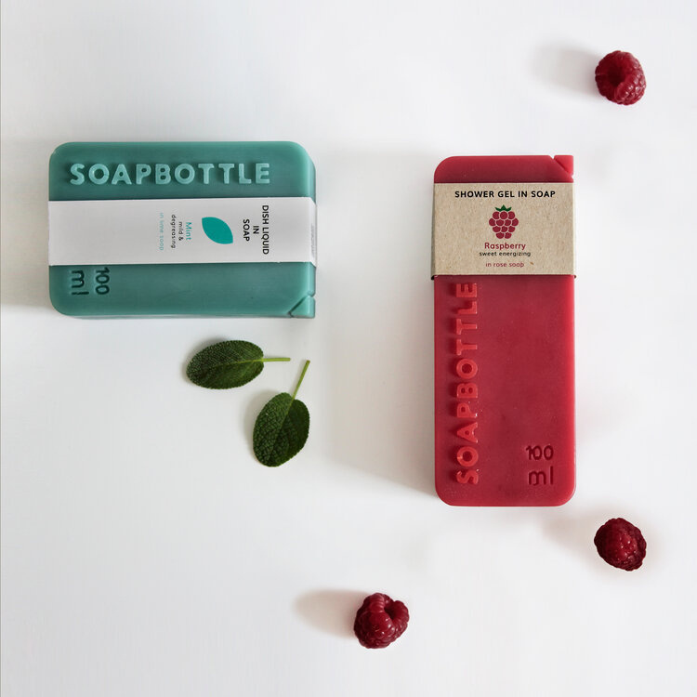
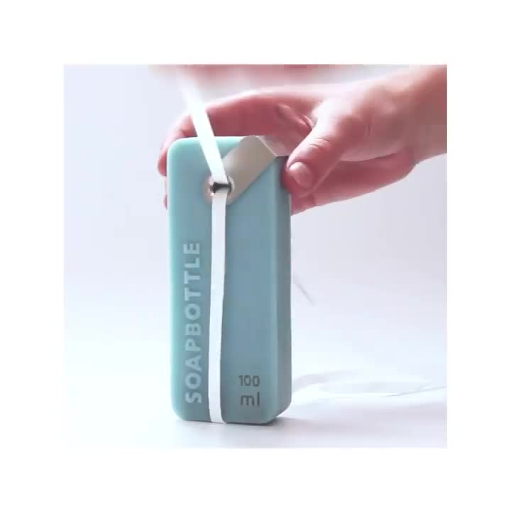
Meet SOAPBOTTLE, a new line of personal care that comes in packaging made from soap. Once the liquid content is finished, the empty container can be used as hand soap and “washes away” over time. Waste can be completely avoided.
SOAP BOTTLE
Packaging made from soap

Slide 5

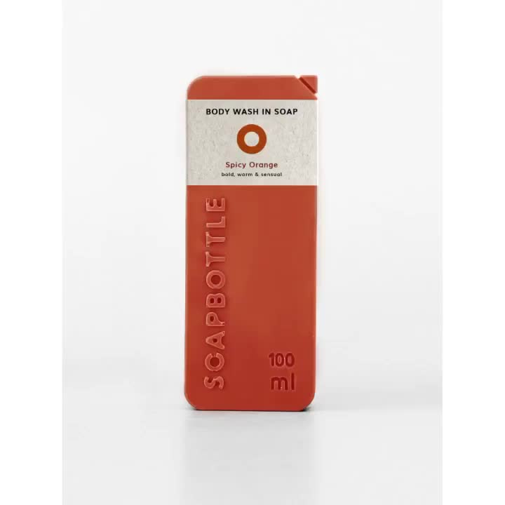
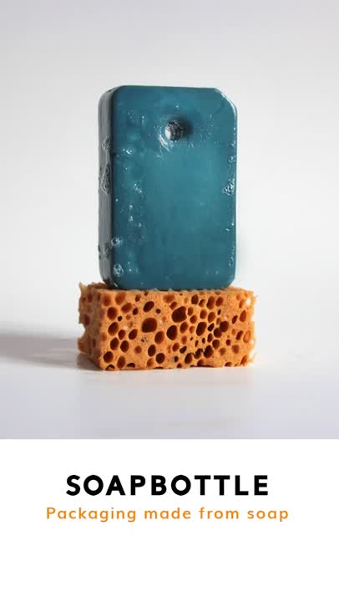
BOTTLE DESIGN
Packaging:
The soap for the packaging is made from organic ingredients, oils, and caustic soda. While the container is used, the material washes away together with the used water. Next, it decomposes entirely into the sewage plant after a few days. There you have it, no waste!
Metal closure:
Made from stainless steel, the closure is stamped and bent into the shape. Good news; It's reusable, too! Simply clip the remaining metal piece on the next SOAPBOTTLE. Once it is no longer needed, it is easy to recycle as it is made from metal only.
Paper label:
The label is made from recycled paper and printed with environmentally friendly colours. It can be recycled again.

Slide 6

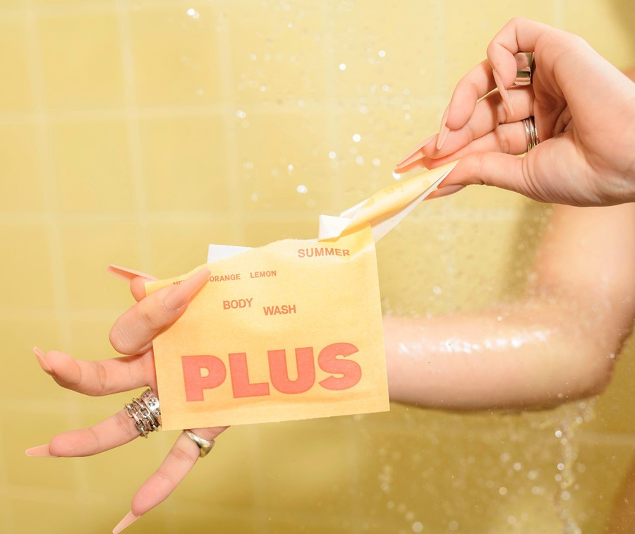
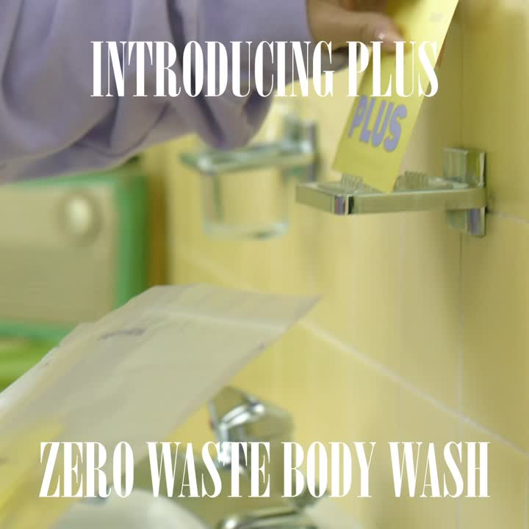
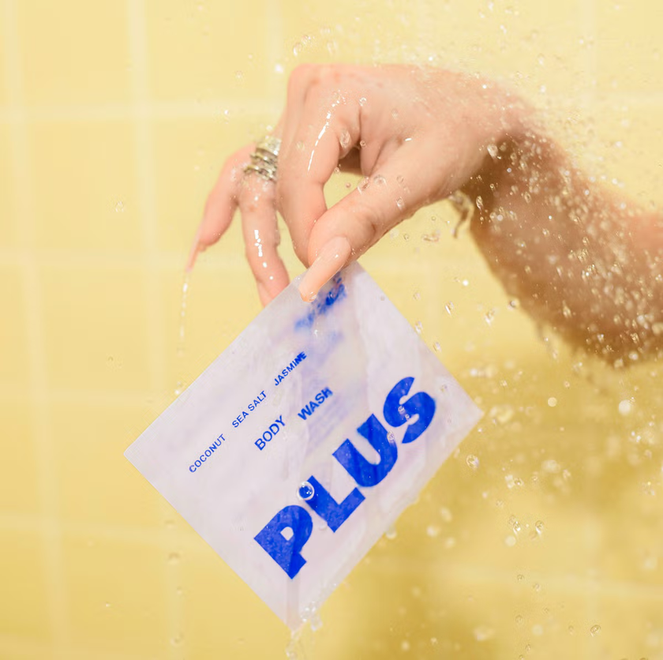
CLEAN WITH PLUS

